Slide 1
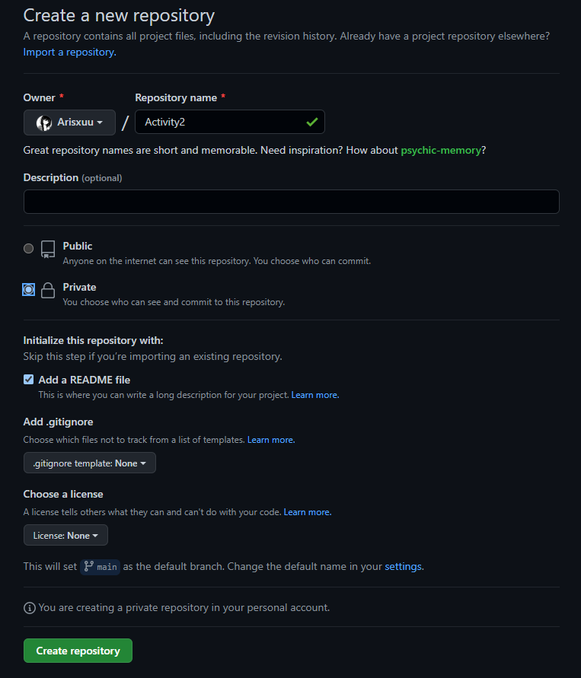
Make repository

Slide 2

Clone github repository to local machine

Slide 3

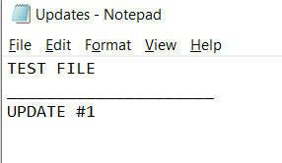
Add file locally

Slide 4
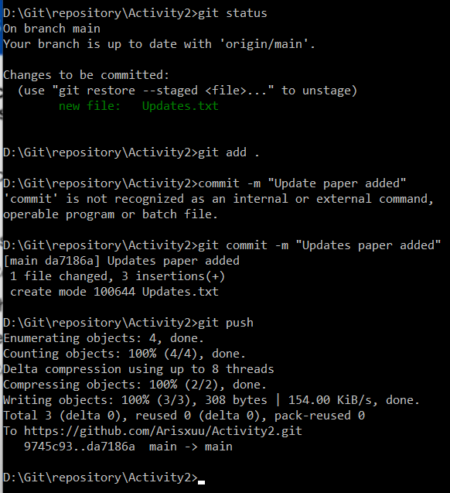
Add new file to github

Slide 5
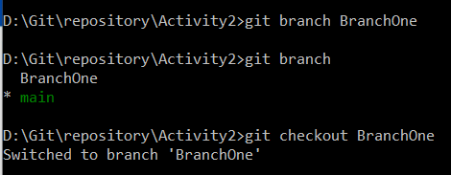
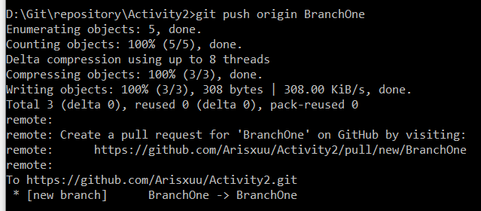
Make and switch to new branch
Additional step to add new branch to github

Slide 6
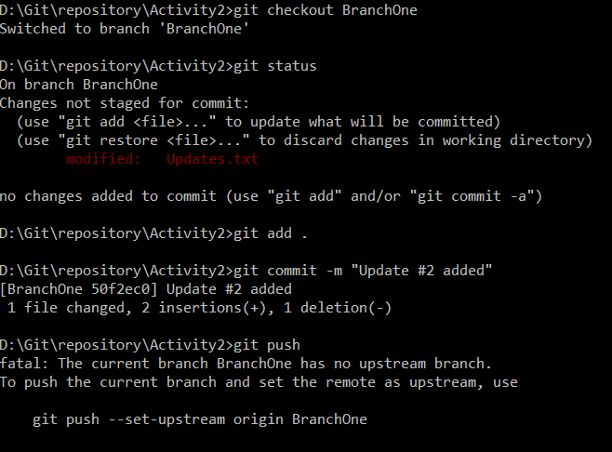
Make and switch to new branch

Slide 7
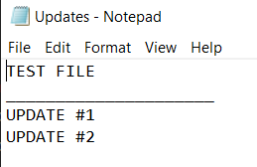
Update file by adding UPDATE #2

Slide 8
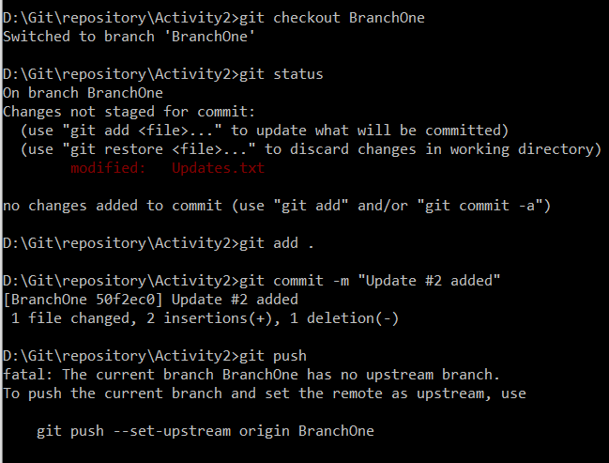
Update file on new branch

Slide 9

Compare & pull request

Slide 10
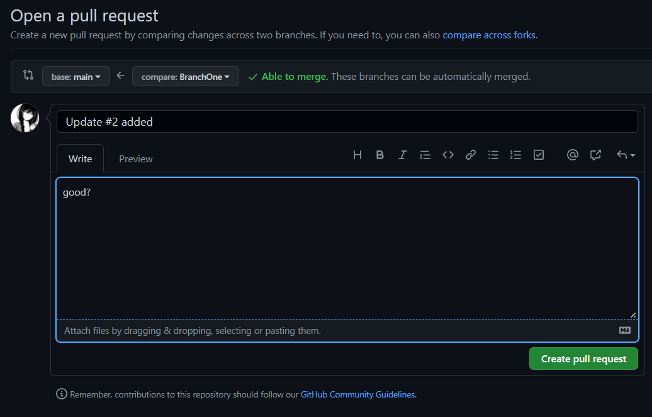

Slide 11




Slide 12
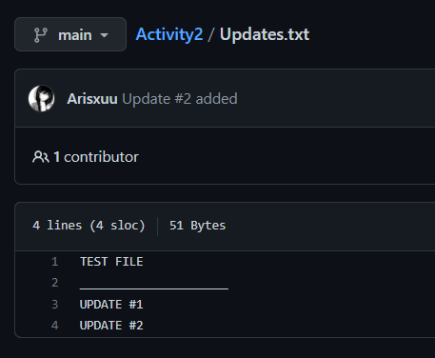
Merge was successful
(UPDATE #2 didn’t exist before)

